Slide 1
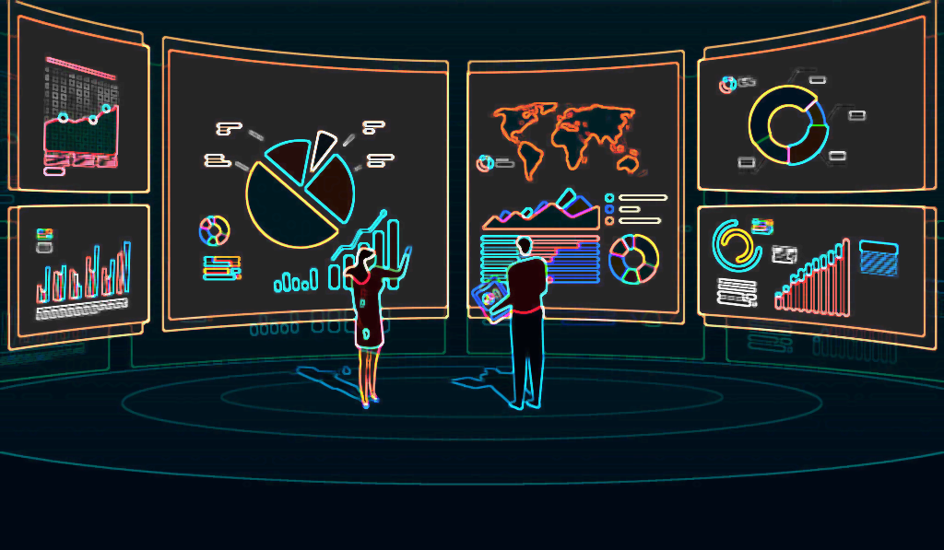
CUSTOMER DATA ANALYSIS
PRESENTED BY:
BERA Pooja
GIBEY Nicolas
SAINTON Samuel
LUONG Trong Bao
VILLEMUR Théophile
CASE STUDY
The STICKS KEBOB

Slide 2

How do people choose a fast-food restaurant to visit ?
According to the survey’s answers provided, respondents think that the taste and satisfaction of the food (“food taste and satisfaction”) is the most important thing to choose a fast-food restaurant. Then, respondents consider the following – in order of importance – as important: “good value for money”, “consistency / reliability”, “convenience place to eat” , “healthy menu options” and “pleasant ambiance”. The less important characteristic for them is to be “part[ed] of a community".

Slide 3
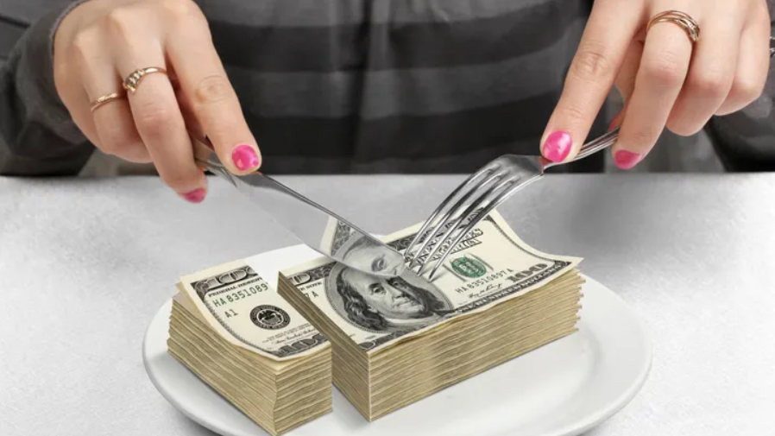
What is important: location, price, assortment, or cuisine?
A multitude of factors influence people’s choice on which fast-food restaurant to visit. These factors include: price they are willing to pay, “quickness”, convenience of location, variety of cuisine, etc. Out of all these factors, We believe that the price (“Good value for money”) and cuisine (“Food taste and satisfaction”) with a scale of 1 out of 5. Then concerning the other criteria which are assortment (“Health menu options”) and place (“Convenient place to eat”) and in relation to the answers of the survey questionnaire these two criteria are considered less important (Somewhat important) than price and cuisine but they still have a scale of 2 out of 5.

Slide 4
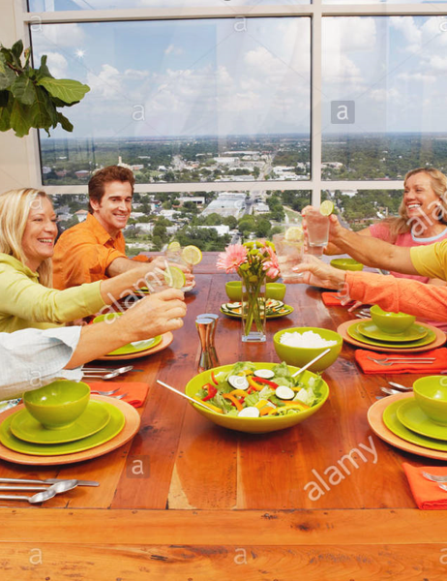
Who do you think are Sticks “customers” and what are their motivations for visiting Sticks?
Based on the survey and on the case study we can say typical customers of this fast-food restaurant are middle-class people around 30 years old who pay attention to what they eat to stay healthy. We can also find families who come to find a nice place for the children for lunch or dinner. There are also workers who have little time for lunch and are looking for something quick and healthy.
The motivations of the customers to come to this place is to find a fast and pleasant service, to find food that will not change their eating habits, to have a wide choice in the menu proposals and finally to have reasonable prices compared to other restaurants in order to find a good relationship between quality and price. In addition, kebobs are usually fond of “fun” foods. Since Sticks does not advertise that they are healthy, the fact that they are both tasty and healthy is a huge plus for their brand.

Slide 5
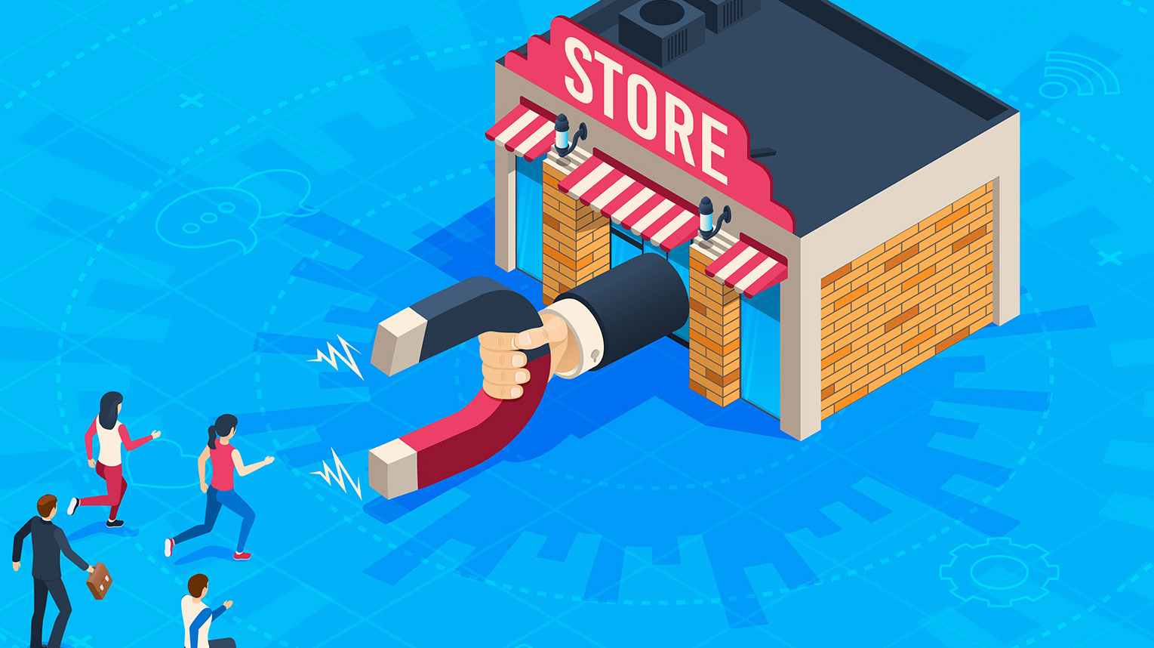
What does the survey data tell us about differences between customers and noncustomers?
As explained in the case the Sticks brand wishes to be considered as a shop that cares about the health of its consumers with its diverse and varied choices that be considered as a simple fast-food that makes a quick service restaurant.
The major difference between customers and non-customers is that during the survey when asked about their preferences regarding fast food they will mention the best-known ones that are not recognized as offering consumers the possibility to consume healthy products while being careful about their health and being restaurant quick services.
The other difference between clients and non-clients concerns age and occupations. Among the non-clients, the majority are students who do not have children, while the main consumers of sticks are families and people with active lifestyles who are looking for a healthy and balanced lifestyle. It can also be seen from the survey and the questionnaire that there is a higher proportion of female than male customers.

Slide 6
What survey questions would you use to identify the customer segments? (1/2)
First, a segment is a group in which the customers within this group have very similar needs. Therefore, we should consider the questions that specify these needs, these are the Q.3 (Please specify the top five restaurants you have visited in the last six months in order of visit frequency) and Q.4 (Please indicate how important the following factors are when you visit a restaurant). Then, regarding the psychographics information, we should use the question about the household lifestyle, activities and hobbies according to Q. 14 (If you have children living at home, in what activities do they participate? Please check all that apply) and Q.15(In what activities or hobbies do you participate yourself?).

Slide 7
What survey questions would you use to identify the customer segments? (2/2)
Also, we should interest ourselves on the purchasing behavior of the customers, these are described on Q.2 (How many times in the last week did you do the following), Q.12, Q.16 (In the last month, how many times have you used coupons when you visited a restaurant) and Q.17(How do you find restaurant coupons? Please check all that apply).
It is also important for Stick to focus on issues related to age and income (from Q.5 to Q.9 according to the survey ) because we know that the clients belong to specific age groups with good incomes.

Slide 8
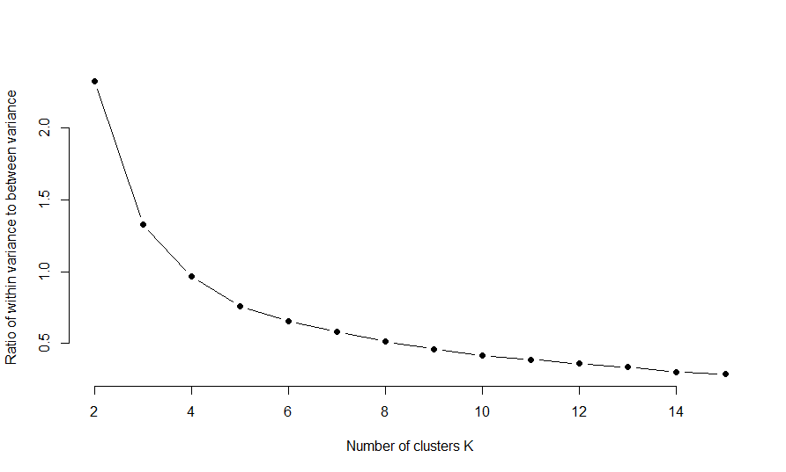
How many customers segments can you estimate from the survey data?
We used the Elbow Plot to find out the number of clusters.
The point at which sharp bends occurs indicated the number of clusters so 5 is the optimal solution .
K-means clustering with 5 clusters of sizes 48, 48, 83, 92, 122.

Slide 9
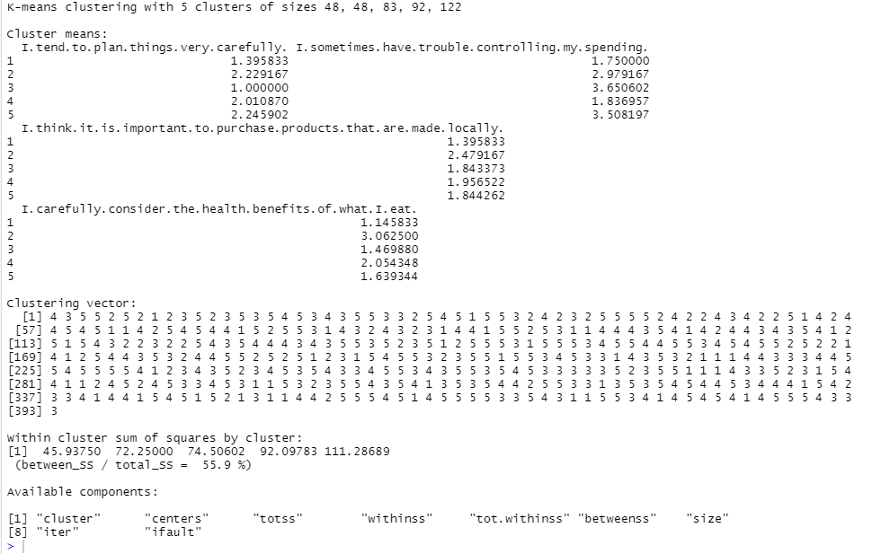

Slide 10
What are the profiles of the customer segments?
We can identify several customer segments based on the case study and the survey which are:
Families with children and who have a good income.
Students in university campus (advertising of the brand in universities to attract).
Professionals aged between 20 and 40 years old who pay attention to their health and have little time to eat.
All other potential consumers who spend money on meals.

Slide 11
Which customer segment should stick target?
The main targets that Stick needs to focus on are those that can give them good publicity but also meet the needs of consumers who are looking for good quality food with choice and not too expensive.
For this reason, it is important that Stick focuses on two targets which are:
Families and their children who can buy food quickly during a trip or eat directly on the place.
Professionals who usually come at lunchtime to buy their meals.

Slide 12
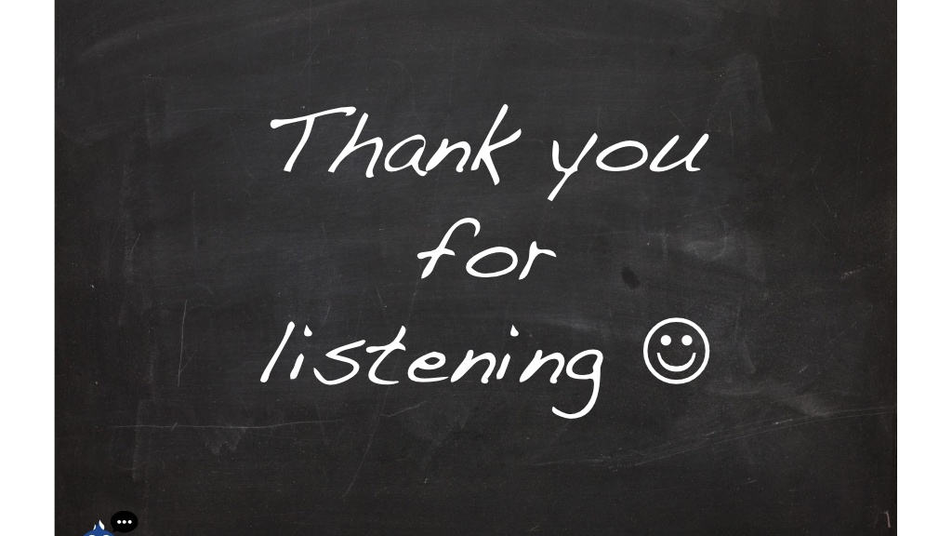
Open for Questions ?

